Slide 1
Loops with Original Graphic
Part 3
A cross curricular project for Fine Arts

Slide 2
Warm-up
Rows and columns

Slide 3
Creating a shape with images
What information would need to change to:
Have a row of images?
Have a column of images?
Have diagonal of images?

Slide 4
Activity #1
Row of images

Slide 5
Row of images
To make a row of images, the image will move from left to right
The x location moves left to right
You will use a loop
Draw an image in the loop
And then
Increment x inside the loop

Slide 6
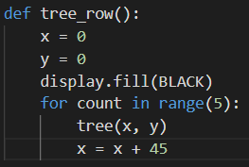
Row of images
Create a function for a row of images
Assign initial values for x and y
Fill the screen
Start a for loop
Decide how many images will fit across the screen
Use this number as your range
Call the holiday image
Increment x
Decide how much x needs to change for the next image

Slide 7
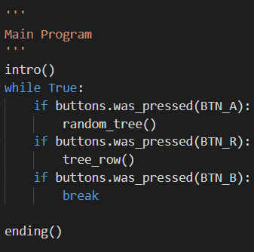
Row of images
Decide what button you want to press to get a row of images
Add an instruction in intro() to tell the user what button to press
Add an if statement in the main program for the button
Run and test the code. Do you get a row of images and a random image with button presses?

Slide 8
Activity #2
Column of images and diagonal images

Slide 9
Column of images
To make a column of images, the image will move from top to bottom
The y location moves top to bottom
You will use a loop
Draw an image in the loop
And then
Increment y inside the loop

Slide 10
Column of images
Create a function for a column of images
Assign initial values for x and y
Fill the screen
Start a for loop
Decide how many images will fit down the screen
Use this number as your range
Call the holiday image
Increment y
Decide how much y needs to change for the next image

Slide 11
Column of images
Decide what button you want to press to get a column of images
Add an instruction in intro() to tell the user what button to press
Add an if statement in the main program for the button
Run and test the code. Do you get a column of images, a row of images and a random image with button presses?

Slide 12
Diagonal images
To make diagonal images, the image will move from top to bottom and left to right
The x location moves left to right
The y location moves top to bottom
You will use a loop
Draw an image in the loop
And then
Increment both x and y inside the loop

Slide 13
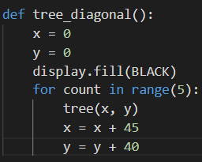
Diagonal images
Create a function for diagonal images
Assign initial values for x and y
Fill the screen
Start a for loop
Decide how many images will diagonally on the screen
Use this number as your range
Call the holiday image
Increment x (can be the same or different as the row of images)
Increment y (can be the same or different as the column of images)

Slide 14
Diagonal images
Decide what button you want to press to get diagonal images
Add an instruction in intro() to tell the user what button to press
Add an if statement in the main program for the button
Run and test the code. Do you get a column of images, a row of images, diagonal images and a random image with button presses?

Slide 15
Activity #3
Grid of images

Slide 16
Grid of images
To make a grid of images, you will create rows of columns of images
You will need two loops
One loop will be inside – or nested – inside the other loop
One loop will increment y (for the columns)
The other loop will increment x (for the rows)

Slide 17
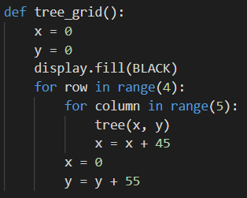
Grid of images
Create a function for a grid of images
Assign initial values for x and y
Fill the screen
Start a for loop
This will be how many rows (y) you have
Inside the loop, start another loop
This will be how many images across (y) you have
Call the holiday image
Increment x
When the inside loop ends,
Reset x to 0
Increment y

Slide 18
Grid of images
Can you explain what is happening in the code?
This creates one row of 5 images
This repeats the row of 5 images four times
Each time the row is repeated, x must start over and y must be increased to begin a new row

Slide 19
Grid of images
Decide what button you want to press to get a grid of images
Add an instruction in intro() to tell the user what button to press
Add an if statement in the main program for the button
Run and test the code. Do you get a column of images, a row of images, diagonal images, a grid of images and a random image with button presses?

Slide 20
Challenge
A different shape of images

Slide 21
A different shape
What other shape of images can you create
How about a triangle?
A square outline?
Other shapes?

Slide 22
A different shape of images
Think about the changes need to make a different shape
HINT: to make a triangle, use a variable for the row’s range and increment it after the inside loop
(increase the number of images in the row each time)
You can do a similar upside down triangle by starting with the max number in a row and decreasing the range

Slide 23
A different shape
You only have 6 buttons to work with
You want one of the buttons to exit the program
So you can have up to five options with the image
If you add a challenge, then take out one of the earlier options for something more interesting

